Slide 1

AdventureWorks Workforce Insights
Post-Merger HR Analysis
Presented by: Lubana Akter

Slide 2
The Merger Created An Urgent Need For Clear Workforce Visibility
1
2
3
Combined Workforce
Historical Data
Executive Visibility
290 active employees across departments.
Hiring & departmental history (2006–2013).
Leadership needs clear workforce insights.

Slide 3

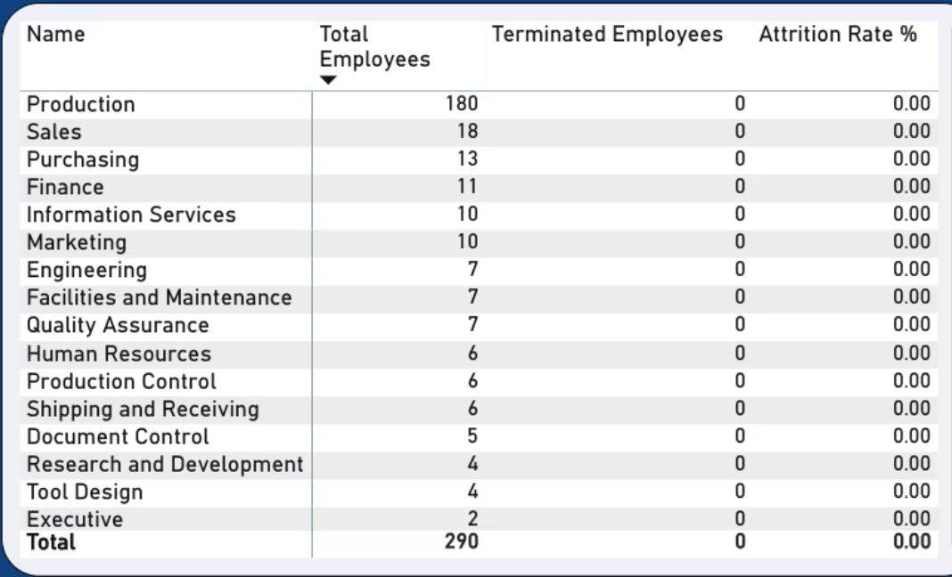
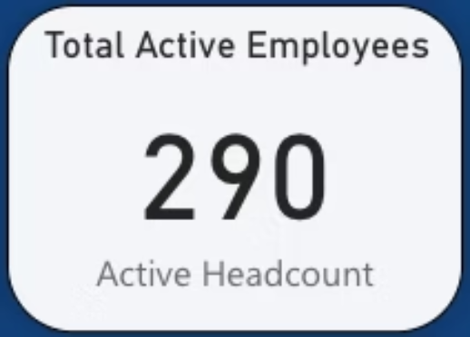
Data Limitations & Insights
All employees marked active
Attrition appears 0% due to missing exit data

Slide 4
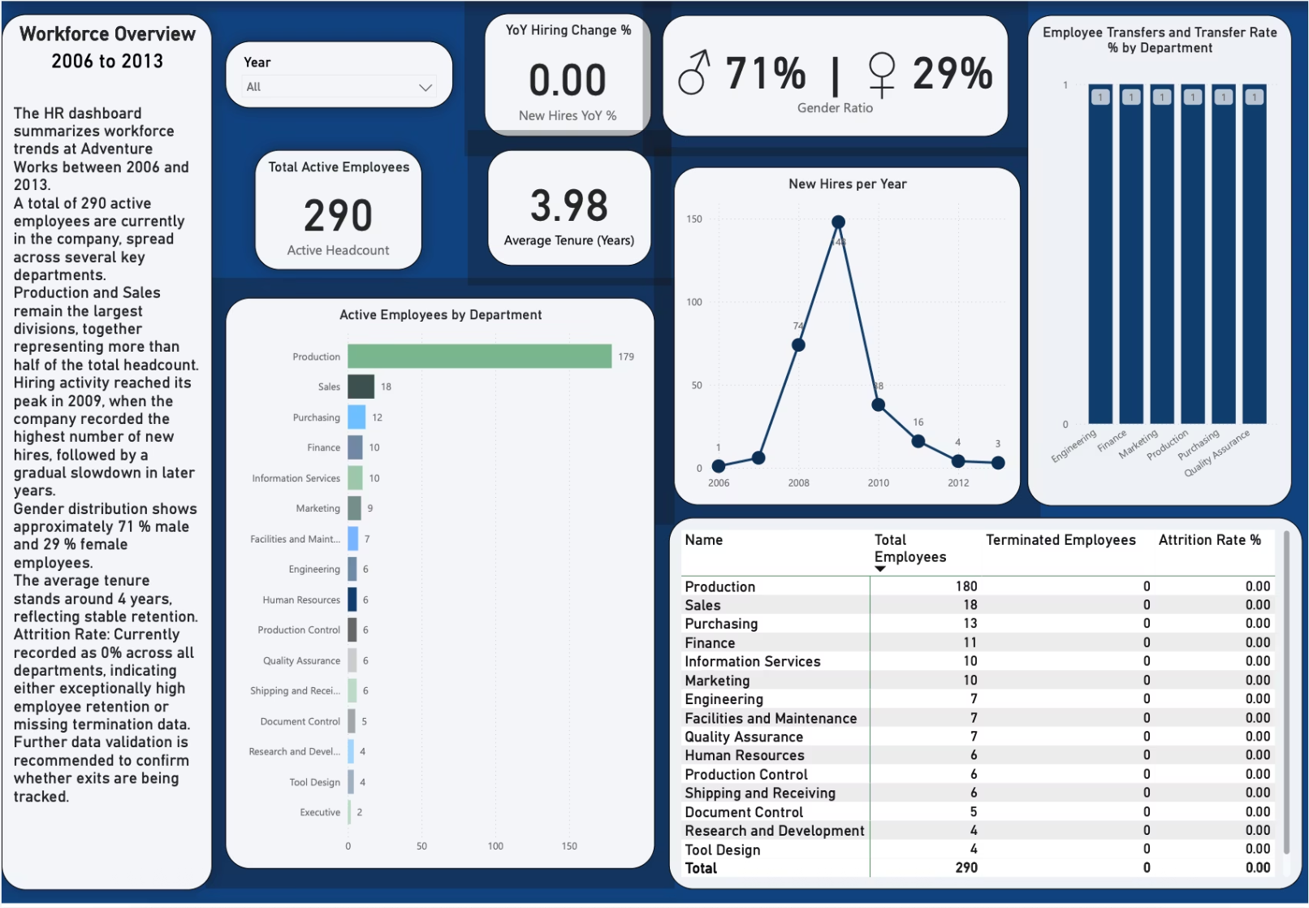
The Dashboard Reveals Trends In Hiring, Structure, Tenure, And Mobility

Slide 5

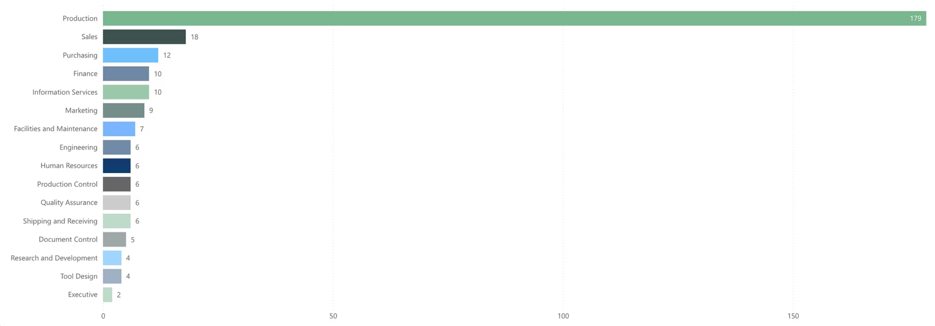
Over 60% Of Employees Sit In Production, 10+ Departments <10 Employees

Slide 6

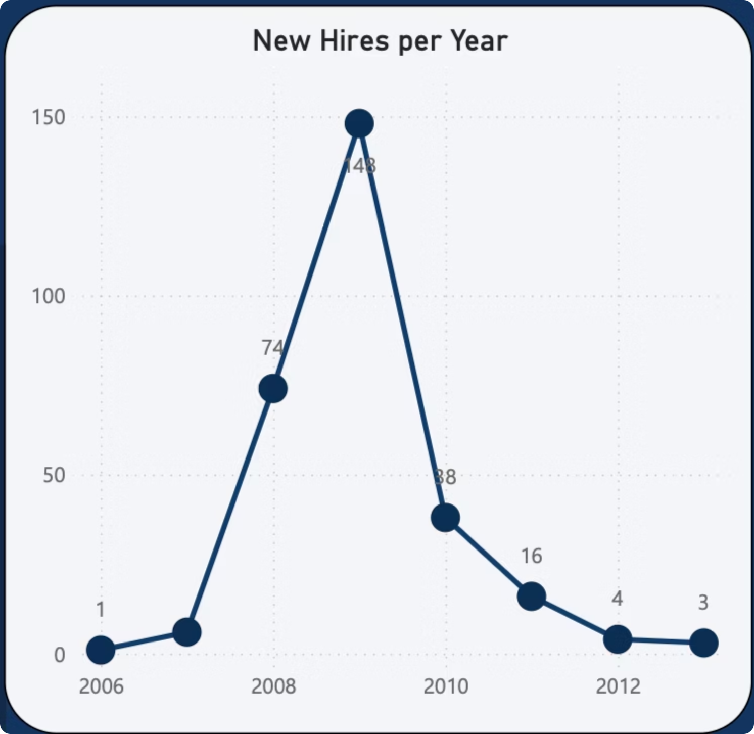
Volatile Hiring & Limited Mobility
Unstable Growth
Phased Evolution
Stagnant Move
Major hiring volatility (2009 spike: 148 hires, then decline).
Departmental hiring windows show lack of integrated planning.
Extremely limited internal mobility (near zero transfer rate).

Slide 7
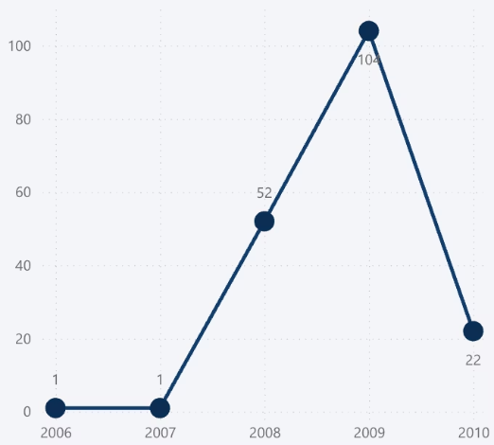
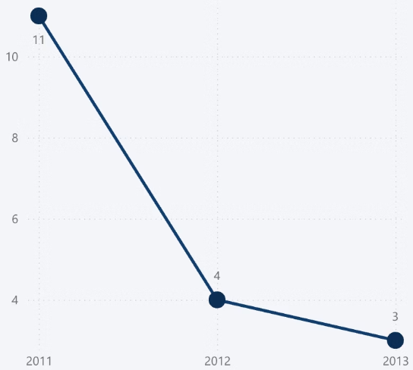
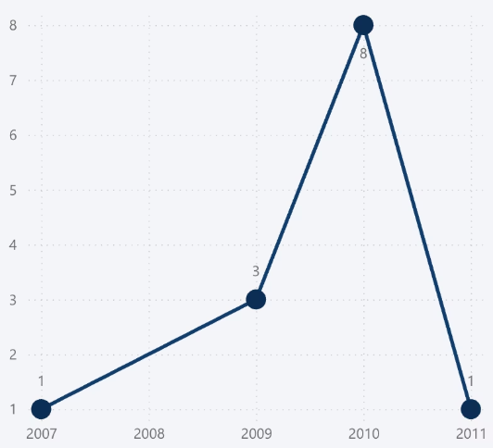
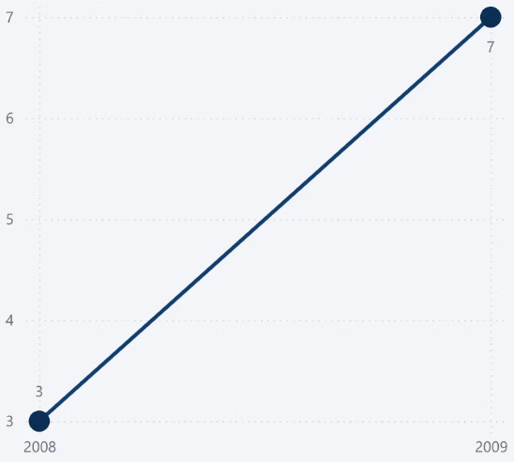
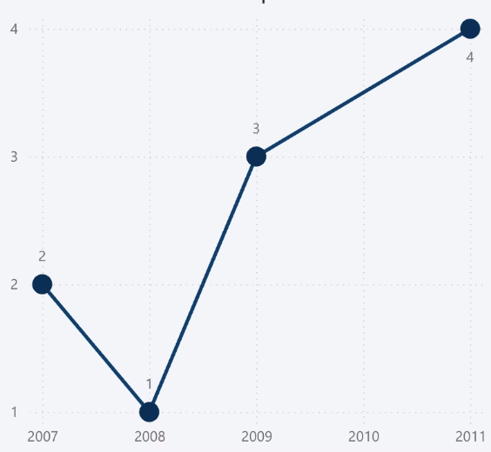
Hiring Waves Evolved By Function Across Different Years
Production hires: 2006–2010
Sales hires: 2011–2013
Purchasing 2007-2011
Finance and Information Service
Marketing: 2007-2011

Slide 8

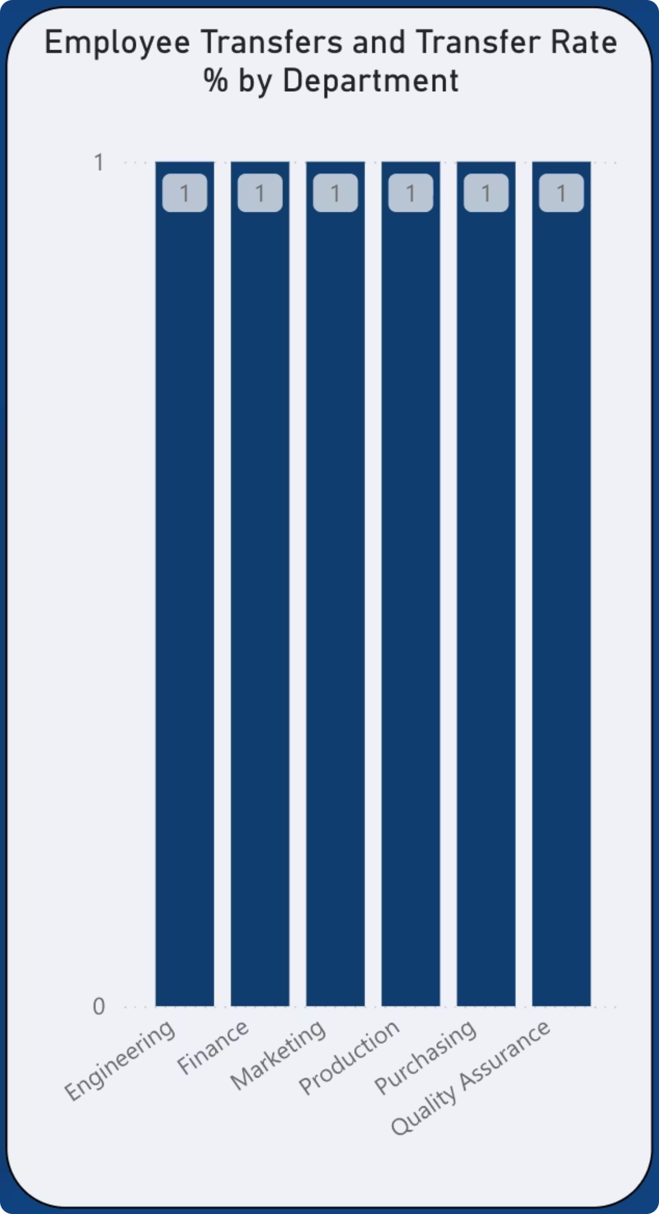
Internal Mobility Is Extremely Limited Across Departments
Only One Transfer Per Active Department

Slide 9
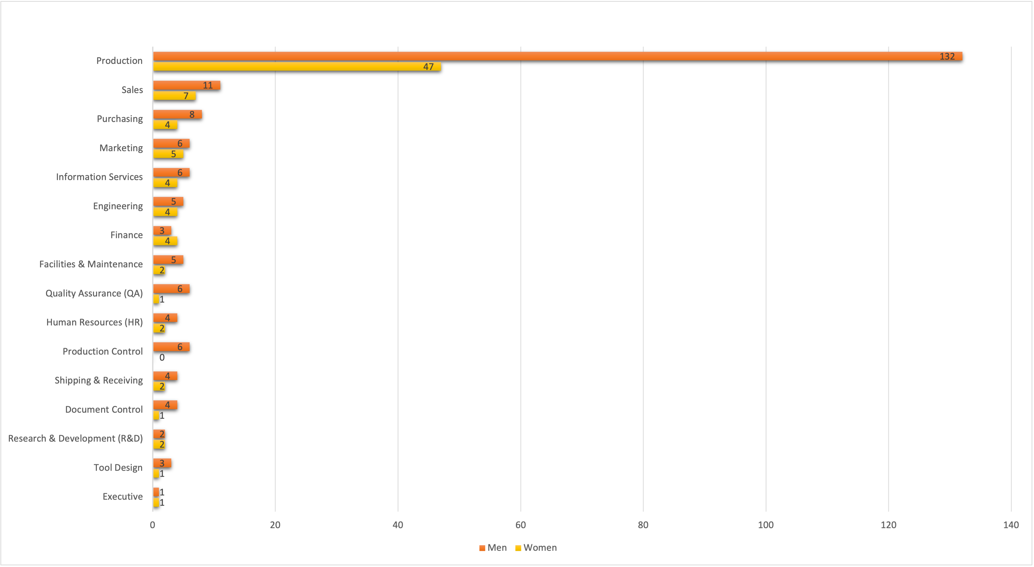
Gender Imbalance
Overall: 71% male / 29% female
No women in Production Control.
Most roles skew male.

Slide 10
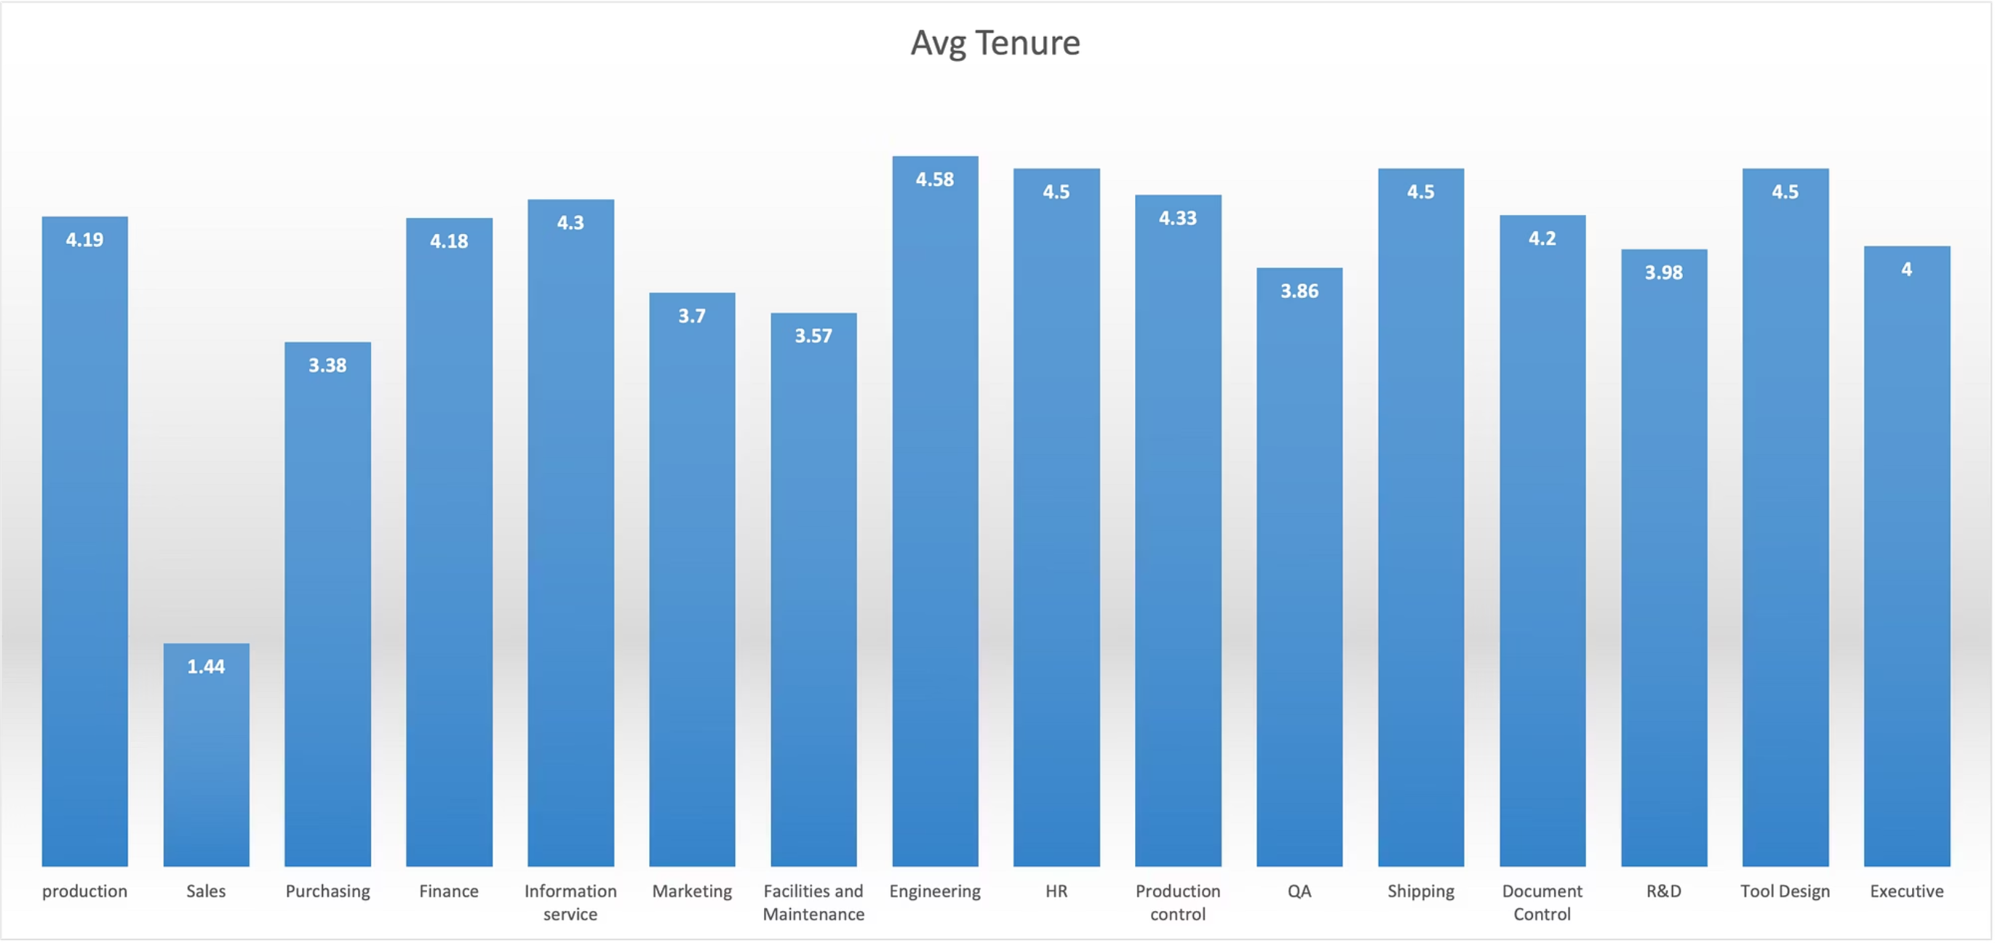
Tenure Is Stable Overall But Lower In Sales
Most departments: around 4 years
Sales tenure = 1.44 years

Slide 11


Missing Termination And Exit Data Creates Analytical Blind Spots
Attrition cannot be computed
Lifecycle tracking incomplete

Slide 12

A Balanced And Insight-driven Workforce Model
Rebalance Structure
Demand-Based Hiring
Strengthen Mobility
Reduce Production dependency; resource critical functions.
Develop cross-functional expertise via rotational programs.
Replace reactive cycles with forecasting models.

Slide 13
Rebalance Headcount To Reduce Production Dependency
Department
Current Headcount
Recommended
Production
179
Reduce dependency, redistribute to supporting functions
Sales
18
Maintain current level
Purchasing
12
Maintain
Engineering
7
Increase to 12–15
Quality Assurance (QA)
7
Increase to 10–12
Research & Development (R&D)
4
Increase to 8–10
Human Resources (HR)
6
Increase to 8–10
Information Services
10
Maintain
Finance
11
Maintain
Marketing
9
Maintain
Facilities & Maintenance
7
Maintain
Production Control
6
Evaluate for consolidation
Shipping & Receiving
6
Maintain
Document Control
5
Consolidate with related support functions
Tool Design
4
Consolidate or upskill depending on demand
Executive
2
Maintain

Slide 14

Develop Cross-functional Mobility Pathways
Production
Engineering
Overseeing the manufacturing and assembly process.
Designing and developing the core product architecture.
QA
Ensuring product standards and quality control.

Slide 15

Launch A Diversity Plan With Measurable Goals
Area
Current
Target (3-Year)
Overall Female Representation
29%
40%
Women in Leadership Roles
29%
45%
Women in Technical Roles (Eng/R&D/QA)
20%
35%
Women in Production & Control
0%
15%

Slide 16

HR Data Completeness For Better Analytics
Add TerminationDate + ReasonForExit
Standardize to YYYY-MM-DD
Fix CurrentFlag workflow
Capture TransferReason + Start/End Dept

Slide 17

Resilient, Diversified, And Future-ready Workforce
Rebalanced headcount across critical and technical functions
Forecast-led hiring model supports stability
Clear pathways for internal movement and leadership growth
Unified HR data foundation supports full lifecycle tracking

